Slide 1
Uses…
This a basic presentation that can be freely edited and used to explain WSPRlite and DXplorer at club meetings etc.
Delete this slide before use!
73 Richard G3CWI

Slide 2
WSPRliTE for
DXplorer
from www.sotabeams.co.uk
A brief introduction…

Slide 3

What is WSPR?
Weak Signal Propagation Reporter “WSPR” is a digital mode used for beacon transmissions
It was invented by Professor Joe Taylor, K1JT a Nobel prize winning physicist (photo)
It’s not a communications mode
It excels at being receivable below the noise
Transmission and reception is largely automatic
Results appear in real-time on the internet

Slide 4
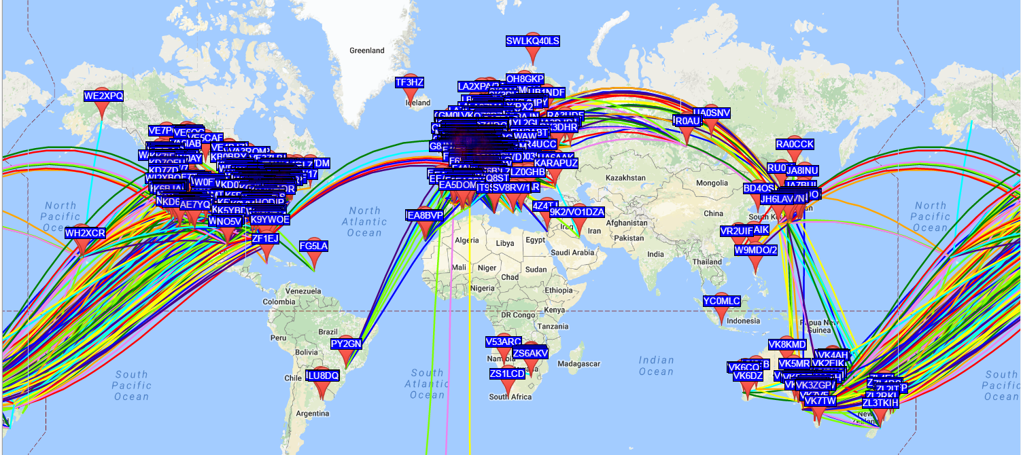
Finding out about WSPR
A good place to start is WSPRnet.org
WSPR is hugely popular – this is the activity in a single 10 minute period!

Slide 5
What can you use it for?
Learning about HF propagation
Seeing how far your radio system will reach
Testing antennas
Comparing antennas with other people
Because it’s largely automatic you can run WSPR while you are not in the shack…
  …basically it’s a lot of fun!

Slide 6
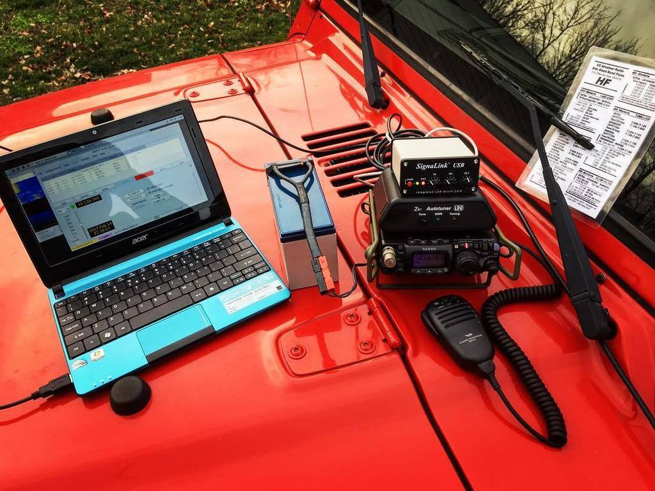
Setting up a beacon
Download WSJT-X software
Configure the software
Dig out (or buy) a radio/computer interface
Try to get your interface to work properly with the software and the radio
Adjust audio and RF levels
Leave your computer and radio on running WSPR
Lots of wire, lots of settings, lots to go wrong.
This process can be tricky to do. It’s not very portable.
It also ties up your shack computer and main radio.

Slide 7
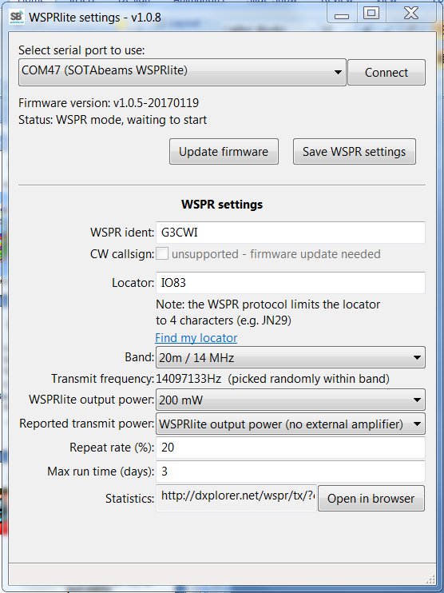

The easy way…
Get a WSPRlite
Configure it using the easy configuration app
Connect it to your antenna
Relax and wait for results

Slide 8
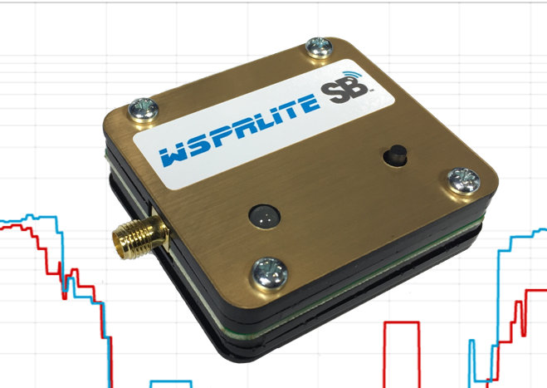
WSPRlite from www.SOTABEAMS.co.uk
USB powered (does not need a computer to run)
200 mW output
Super portable – can even be run from a USB power pack
Built in accurate power levels for antenna comparisons
Runs on 20m or 30m out of the box
160m-80m-40m easily added with external filters
Gives Premium Access to DXplorer.net analysis tools

Slide 9
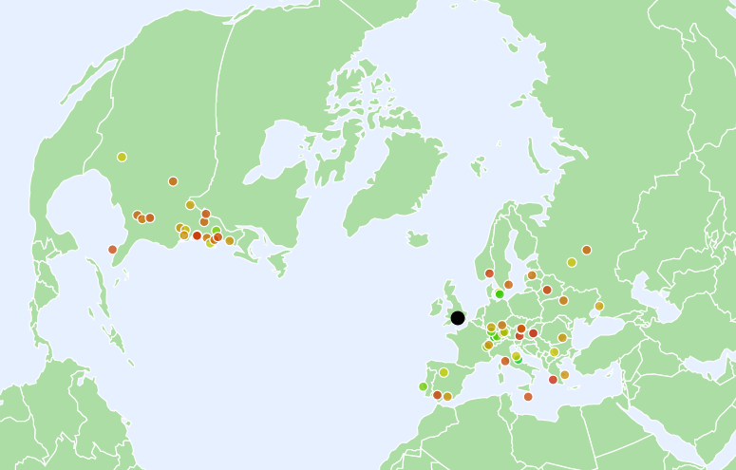
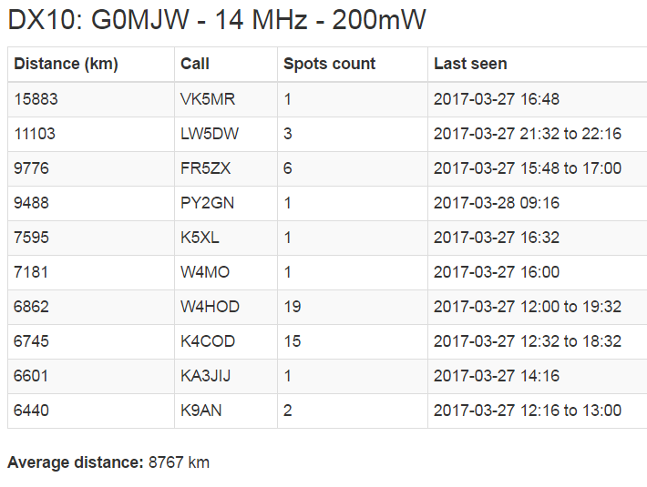
Looking at the results on DXplorer
SPOT DX OPENINGS
How far will you get?
COLOUR CODED SPOTS
SHOW WHERE YOU REACH
AND HOW STRONG YOU WERE
Your best DX spots in order of distance

Slide 10
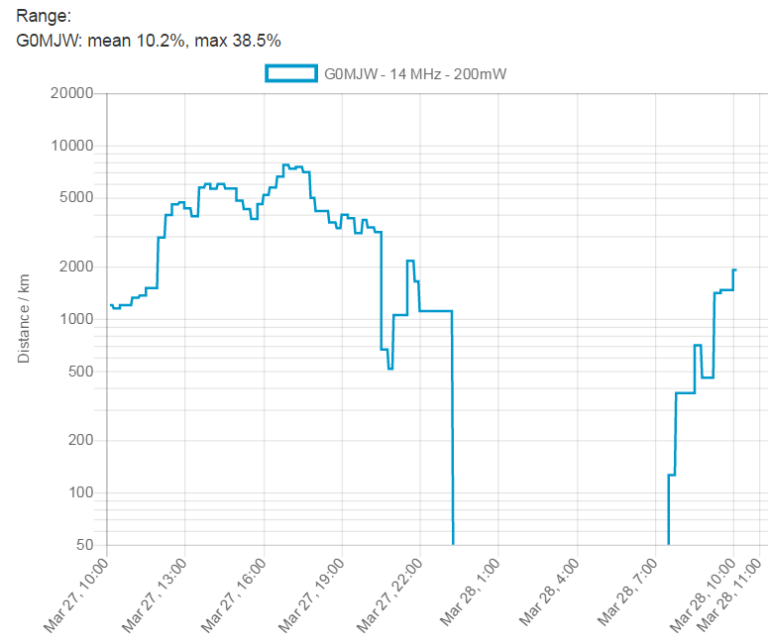
Learning about propagation
See how your DX performance varies with time.
See when the best times for DX are!

Slide 11
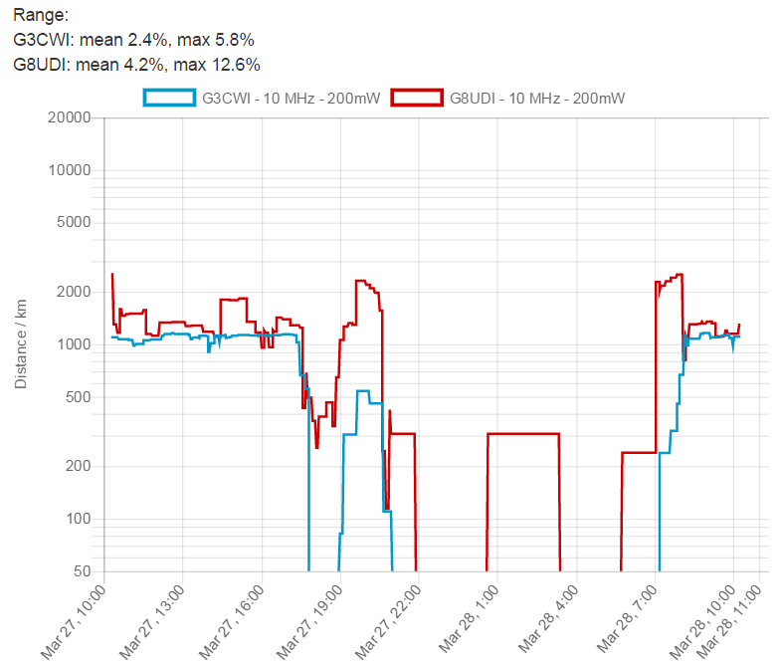
Compare antennas or sites in real time
DXplorer makes it easy to see who has the best station!
This type of analysis is unique to DXplorer

Slide 12
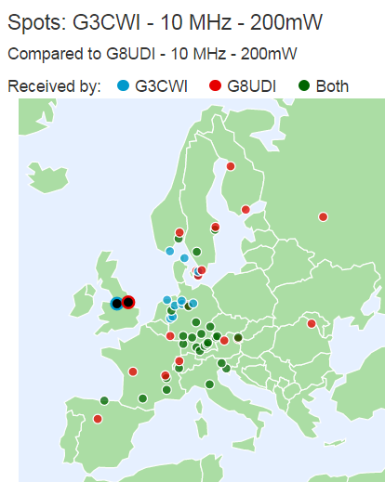
See where your antenna works best!
Colour coded spots show who’s station is best in any location. Great for testing directional antennas.
This type of analysis is unique to DXplorer.

Slide 13
Conclusion
WSPRlite from www.SOTABEAMS.co.uk is a ready made beacon transmitter
Runs out of the box on 20m or 30m
Easy to set up and use
Gives access to unique analysis facilities at DXplorer.net
Users say it’s the most fun thing they have bought for their hobby in years!
I am happy to take questions…

